Slide 1
Reference Slide (Remove before final)
Presentation (25 points)
The presentation itself is worth 25 points, or a full quarter of your grade for the final segment. This is your chance to share a polished, interview or boardroom ready deliverable.
Remember, you won't necessarily be graded on whether or not you've built the very best model. Instead, you'll be graded on your process: How did you select the model, and why? What roadblocks did you encounter (there are always roadblocks!), and how did you solve them?
Content
The presentation should tell a cohesive story about the project and include the following:
1 - Selected topic
1 - Questions the team hopes to answer with the data
2 - Reason the topic was selected
3 - Description of the source of data
4 - Description of the data exploration phase of the project
5 - Description of the analysis phase of the project
6 - Technologies, languages, tools, and algorithms used throughout the project
7 - Result of analysis
8 - Recommendation for future analysis
9 - Anything the team would have done differently
Slides
The presentation should be finalized in Google Slides and include the following:
Slides are primarily images or graphics (rather than primarily text).
Images are clear, in high-definition, and directly illustrative of subject matter.

Slide 2
Pneumonia
Analysis
To sneeze or not to sneeze

Slide 3
Overview
1 - Selected topic
1 - Questions the team hopes to answer with the data
Notes:
Project Use Case
The use case for generating this model is to develop a process to objectively analyze and interpret x-ray images with a rate of accuracy that is potentially better than the human eye.
This model could be a valuable resource for doctors and students as another tool for interpreting x-ray images and validating/invalidating their personal diagnoses.
Our goal is to generate a model that can predict the nuances between pneumonia, normal, or other to account that there are many potential diagnoses besides pneumonia to consider.
Questions to Answer
Can a machine learning model find distinct differences in chest x-ray images and accurately classify them as pneumonia, normal, or other?
What level of accuracy can be achieved by this model? Can it be considered a reliable resource for individuals who are diagnosing patients?
Long term, how can this model be applied to classifying other diagnoses based on x-ray image analysis?
Can this model be generated without introducing bias?

Slide 4
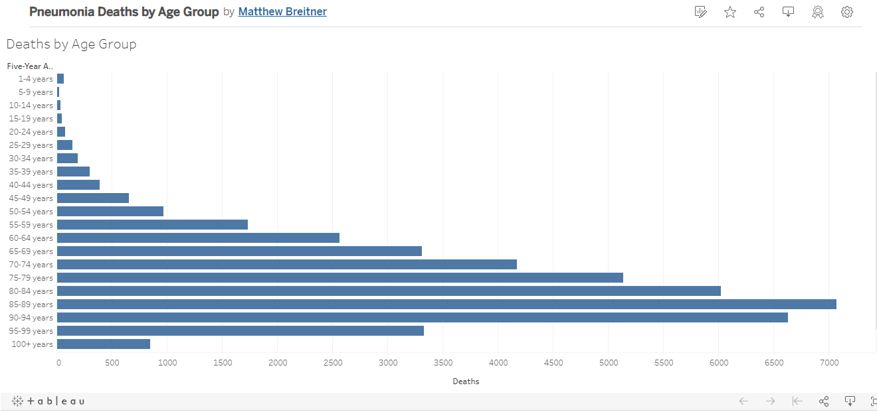
Pneumonia Statistics
2 - Reason the topic was selected
Notes:
Is this just the US?

Slide 5
From 1999 to 2010, a total of 1,517,149 cross-sectional imaging studies (CT = 994,471; MRI = 522,678) comprising 539,210,581 images (CT = 339,830,947; MRI = 199,379,634) were evaluated at our institution. Total annual cross-sectional studies steadily increased from 84,409 in 1999 to 147,336 in 2010, representing a twofold increase in workload (Q = 6465/year, Z = 4.2, P < .0001). Concomitantly, the number of annual departmental cross-sectional images interpreted increased from 9,294,140 in 1990 to 94,271,551 in 2010, representing a 10-fold increase (Q = 8707876/year, Z = 4.5, P < .0001). Adjusting for staffing changes, the number of images requiring interpretation per minute of every workday per staff radiologist increased from 2.9 in 1999 to 16.1 in 2010 (Q = 1.7/year, Z = 4.3, P < .0001).
Conclusions
Imaging volumes have grown at a disproportionate rate to imaging utilization increases at our institution. The average radiologist interpreting CT or MRI examinations must now interpret one image every 3–4 seconds in an 8-hour workday to meet workload demands.
Notes:
https://appliedradiology.com/articles/the-radiologist-s-gerbil-wheel-interpreting-images-every-3-4-seconds-eight-hours-a-day-at-mayo-clinic
https://www.academicradiology.org/article/S1076-6332(15)00245-7/fulltext

Slide 6



Data Sources
Both Datasets were compiled on Kaggle
Images were reviewed at respective sources by qualified Radiologists
Guangzhou Women’s and Children’s Medical Center
5,863 images
Divided into Pneumonia and Normal
Pediatric patients of one to five years old
National Institutes of Health Database
112,120 images
14 different diseases
Collected through NLP mining of radiology reports with >90% accuracy

Slide 7
4 - Description of the data exploration phase of the project

Slide 8
5 - Description of the analysis phase of the project

Slide 9
6 - Technologies, languages, tools, and algorithms used throughout the project
tTechnologies Used
Database Technologies
AWS for data storage
PGAdmin and PostgreSQL for data table generation and manipulation
Google Collab Notebooks for cloud database connection
Machine Learning Technologies
Google Collab for machine learning model generation
cv2 package for image analysis and preparation
TensorFlow package for machine learning model generation
Visualization Technologies
hvplot/plotly for visualizing the outputs of our classification model and results of our model
Tableau Public for additional visualization support
Heroku for hosting visualizations

Slide 10
7 - Result of analysis

Slide 11
Beyond the Model
8 - Recommendation for future analysis
Could this model be further applied to chest x-rays with diagnoses outside of pneumonia and be adapted to interpret the x-rays of patients with an array of diagnoses?
If we set up our database is to take in new images can we use them to periodically update the model to improve the lifelong accuracy of the model?
Building the ability to upload and analyze multi images at a time

Slide 12
9 - Anything the team would have done differently

